Slide 1
mev - wat do next?
Phil Daian | (cornell tech, flashbots)

Slide 2
why are we here? the past
why are you here? the present
wat do next? the future

Slide 3
why are we here? the past

Slide 4
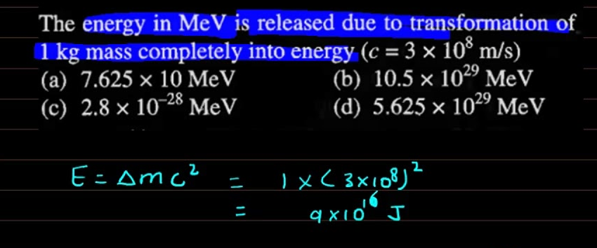
mev

Slide 5
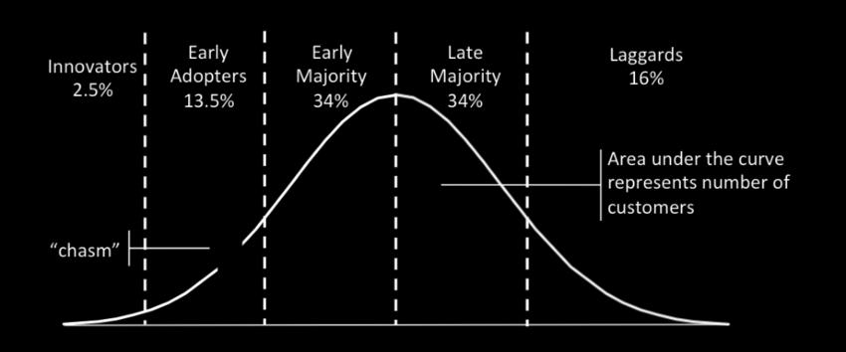
The Hydra “Flaws of Decentralization on 0x and Etherdelta”
Ordering (OO) Fees

Slide 6
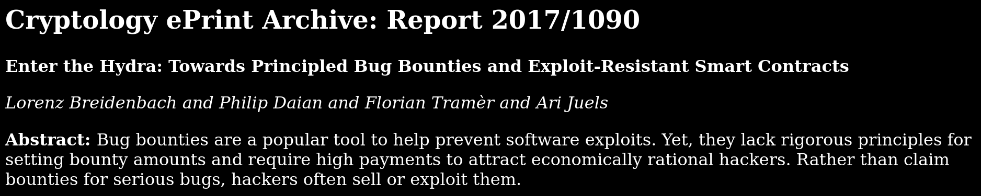
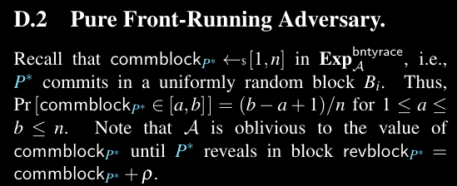

The Hydra : Into the Rabbithole

Slide 7
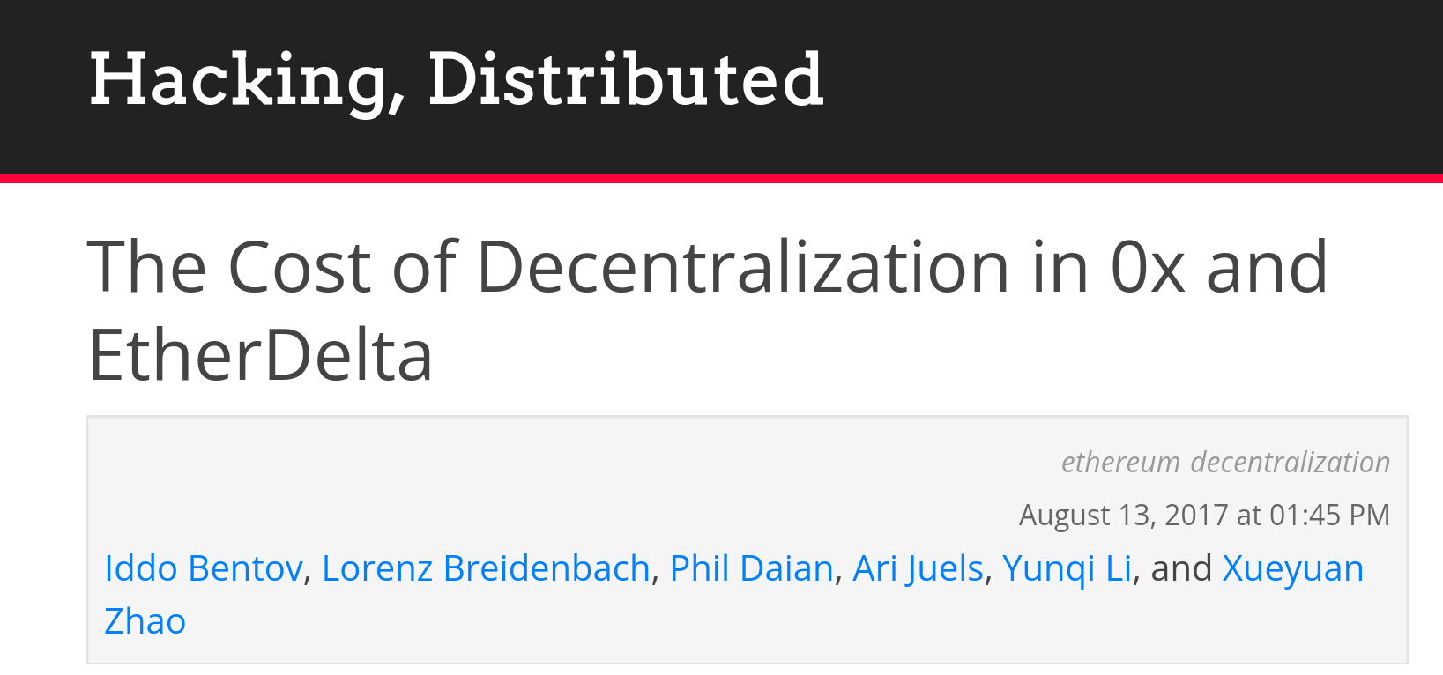
“Flaws of Decentralization”
Issue: exposure to arbitrage, miner frontrunning, exchange abuse
Found $1M/y profit running our own bot. Pre-PGA MEV bot!

Slide 8
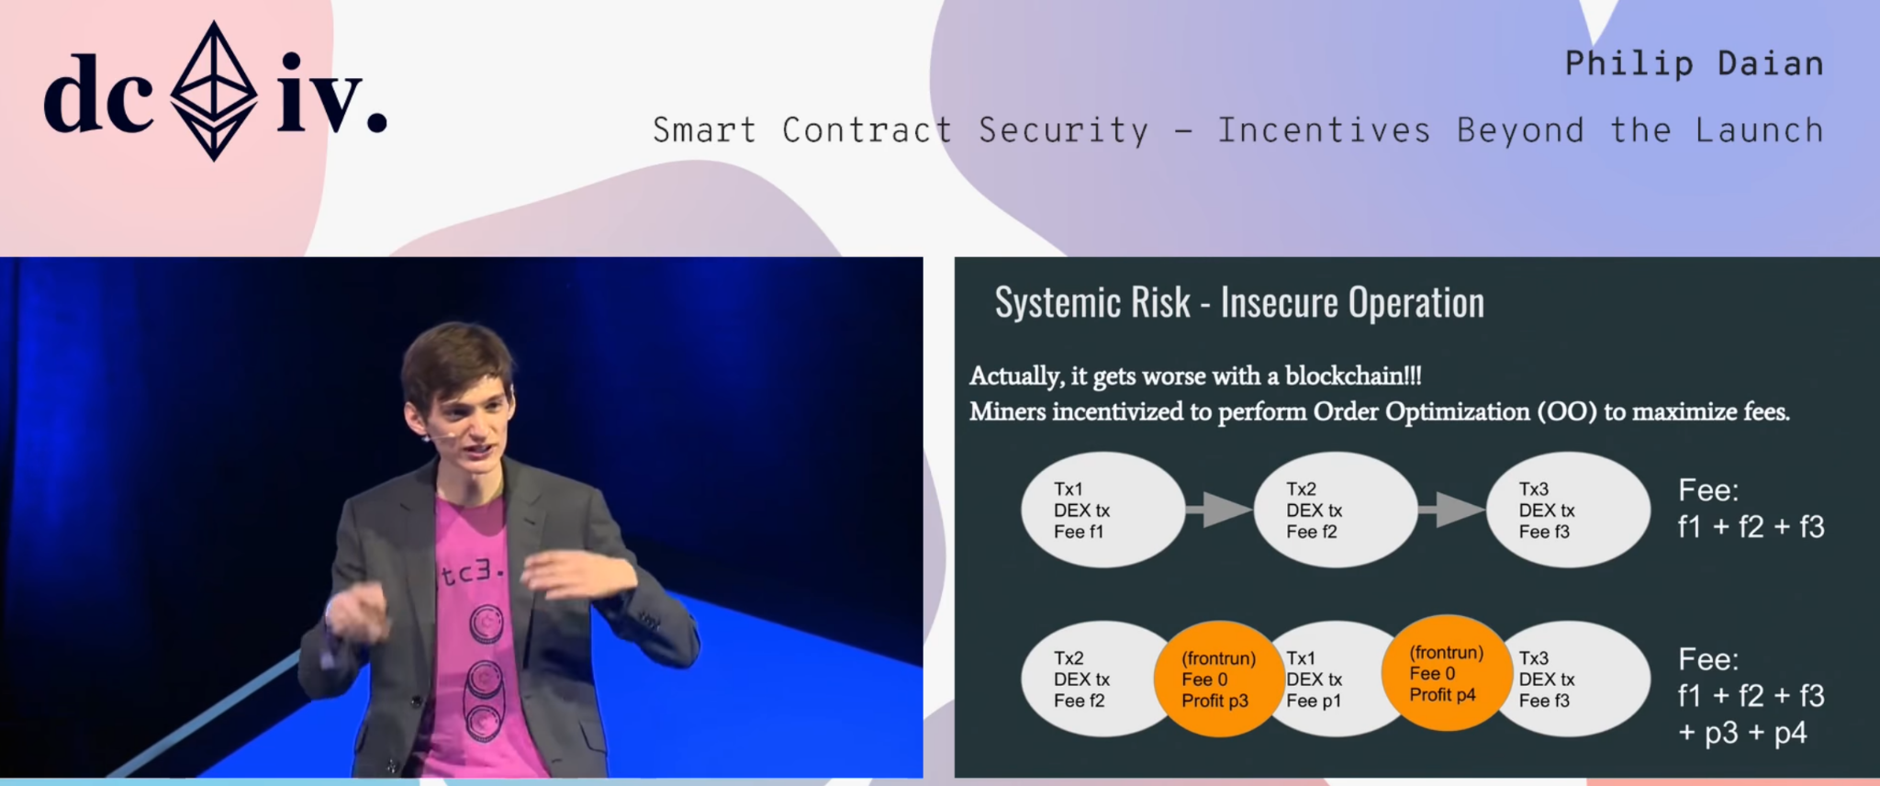
Ordering Fees: One Puzzle Piece

Slide 9
Flash Boys 2.0 (a warning)
“MEV”, “PGA”s - beyond ordering
fair ordering: Themis and more (Kelkar et al)

Slide 10
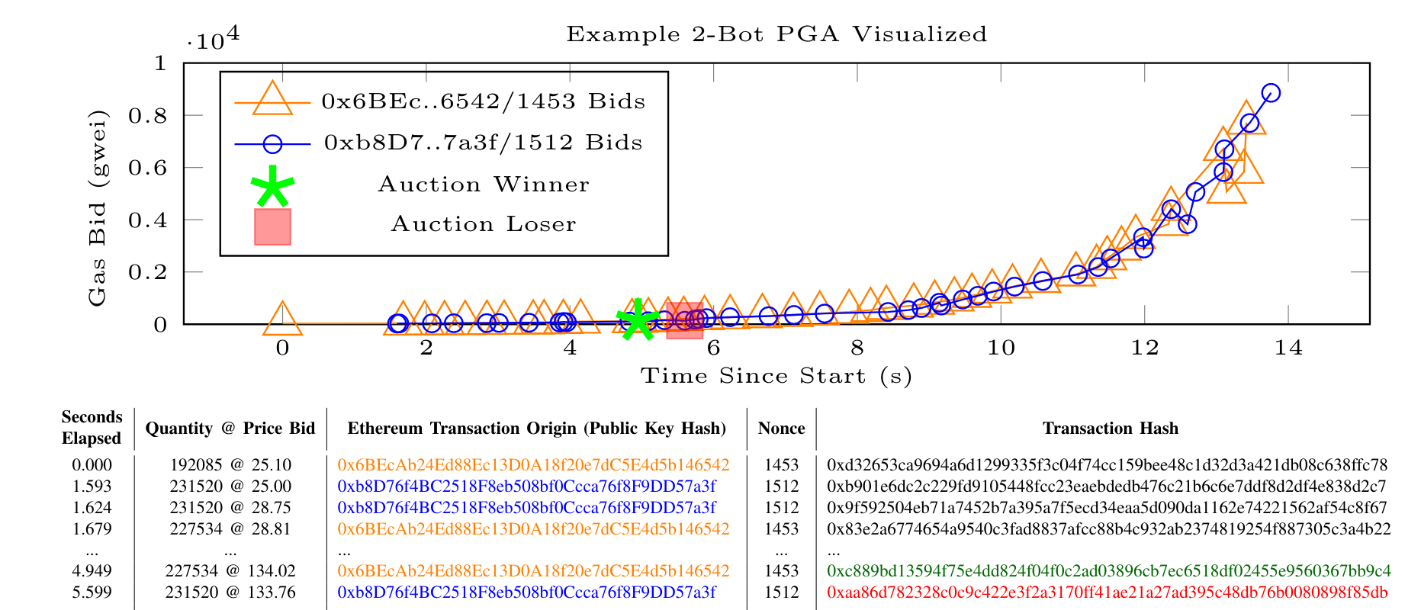
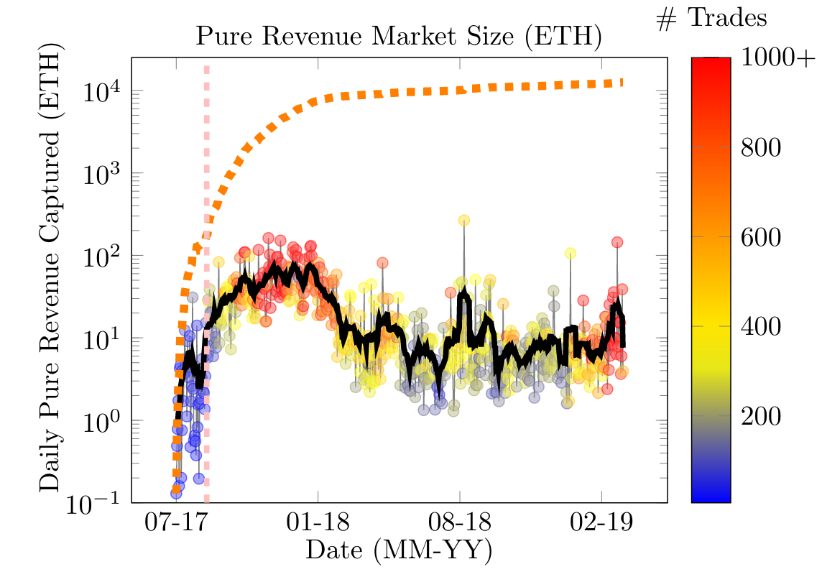
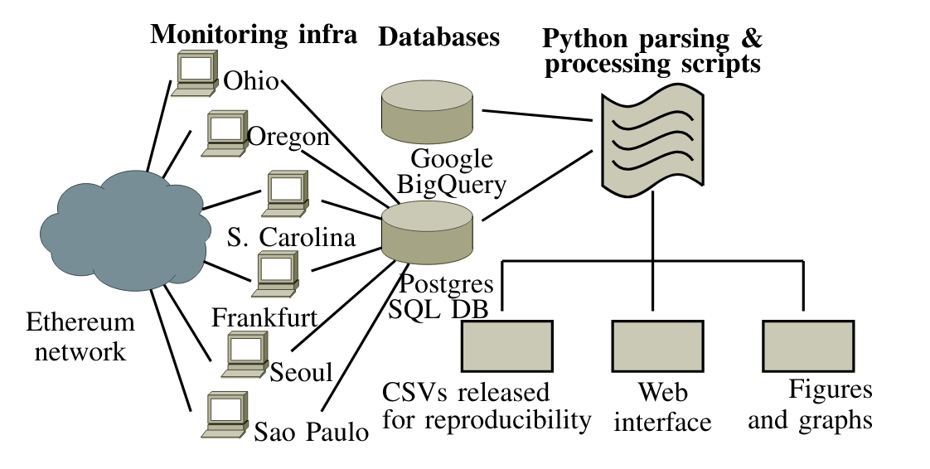
Flash Boys 2.0

Slide 11
mev

Slide 12
Enter MEV
OO fees represent one case of a more general quantifiable value we call miner-extractable value (MEV).
MEV refers to the total amount of Ether miners can extract from manipulation of transactions within a given timeframe, which may include multiple blocks’ worth of transactions.

Slide 13
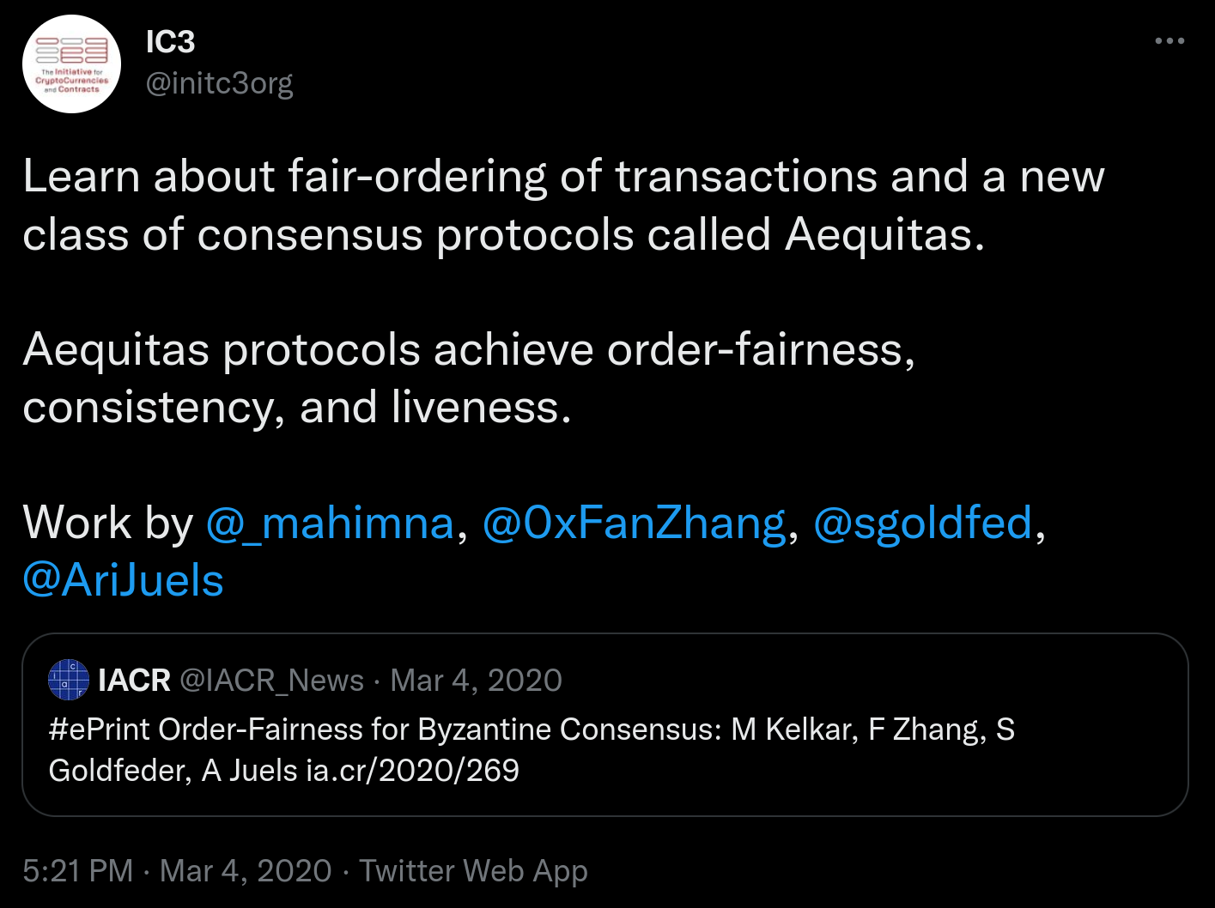
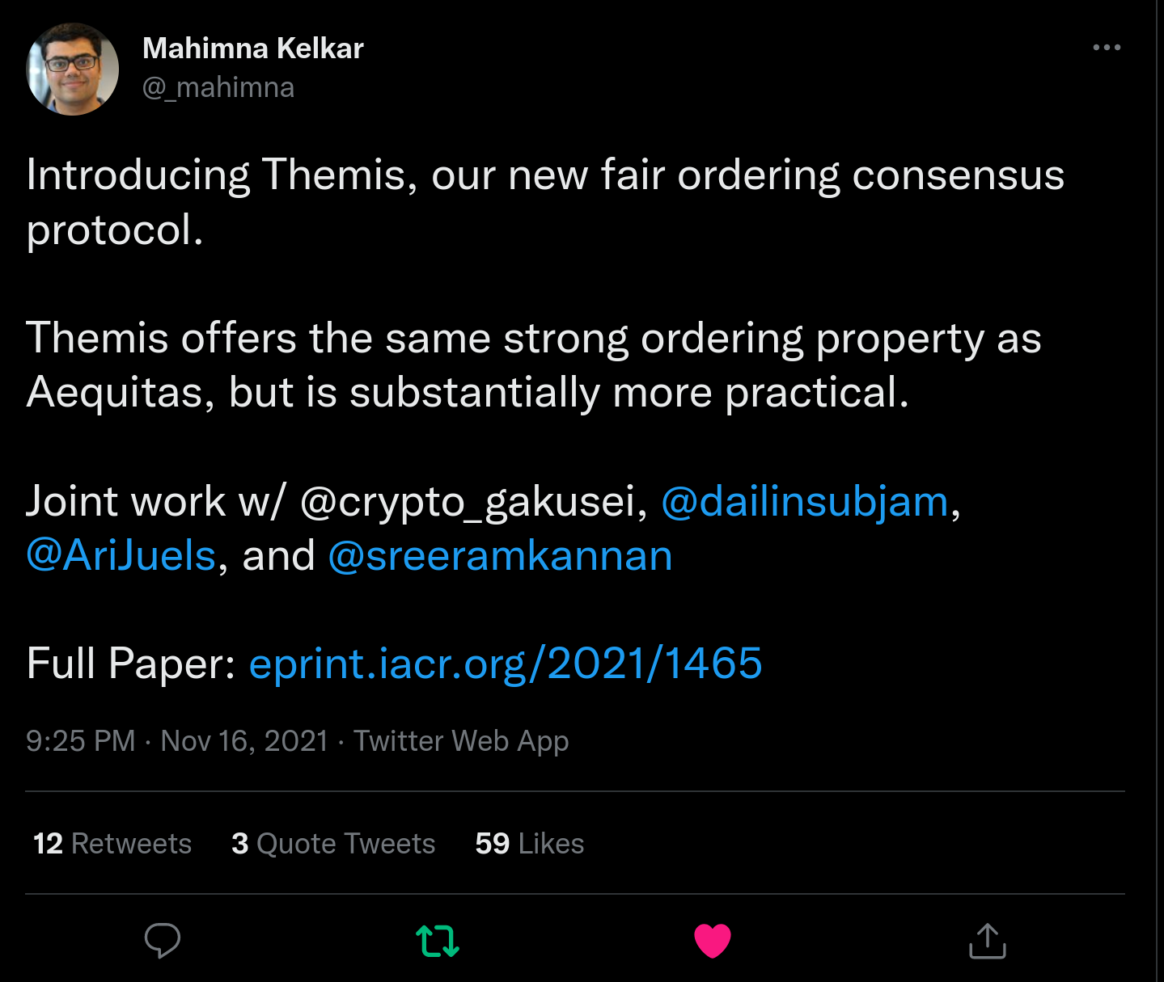
Fair Ordering: A Response

Slide 14
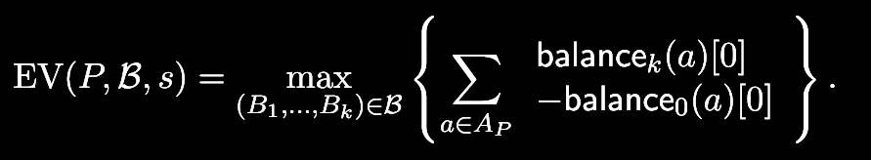
Clockwork Finance: A New Definition
MEV: the amount a miner can increase their balance across a series of blocks

Slide 15
Flashbots
mev: wat do?
… and many other projects

Slide 16
mev wat do?
MEV is fundamental
wat do?
DAPP DEVELOPERS: Limit MEV to what is strictly required/inherent. Think carefully about MEV.
USERS: Demand the above. Don’t use dapps with predatory MEV. Understand what MEV means to you.
L1/L2: Redesign with MEV in mind. Think about the use cases you are designing for, and how best to manage MEV. VALIDATORS: Extract, extract, extract, and don’t be ashamed. Your continued extraction is required to the game-theoretic security of any network on which MEV exists. Everyone else: mitigate 👏 negative 👏 externalities.
transcriptability
interoperability (trust)
“permissionless” design

Slide 17


… the birth of the magic bot
> illuminate the dark forest
> democratize MEV extraction > distribute MEV benefits

Slide 18
why are you here? the present

Slide 19
mev.day!! (you today)
Cross-Chain MEV: a Formalization

Slide 20
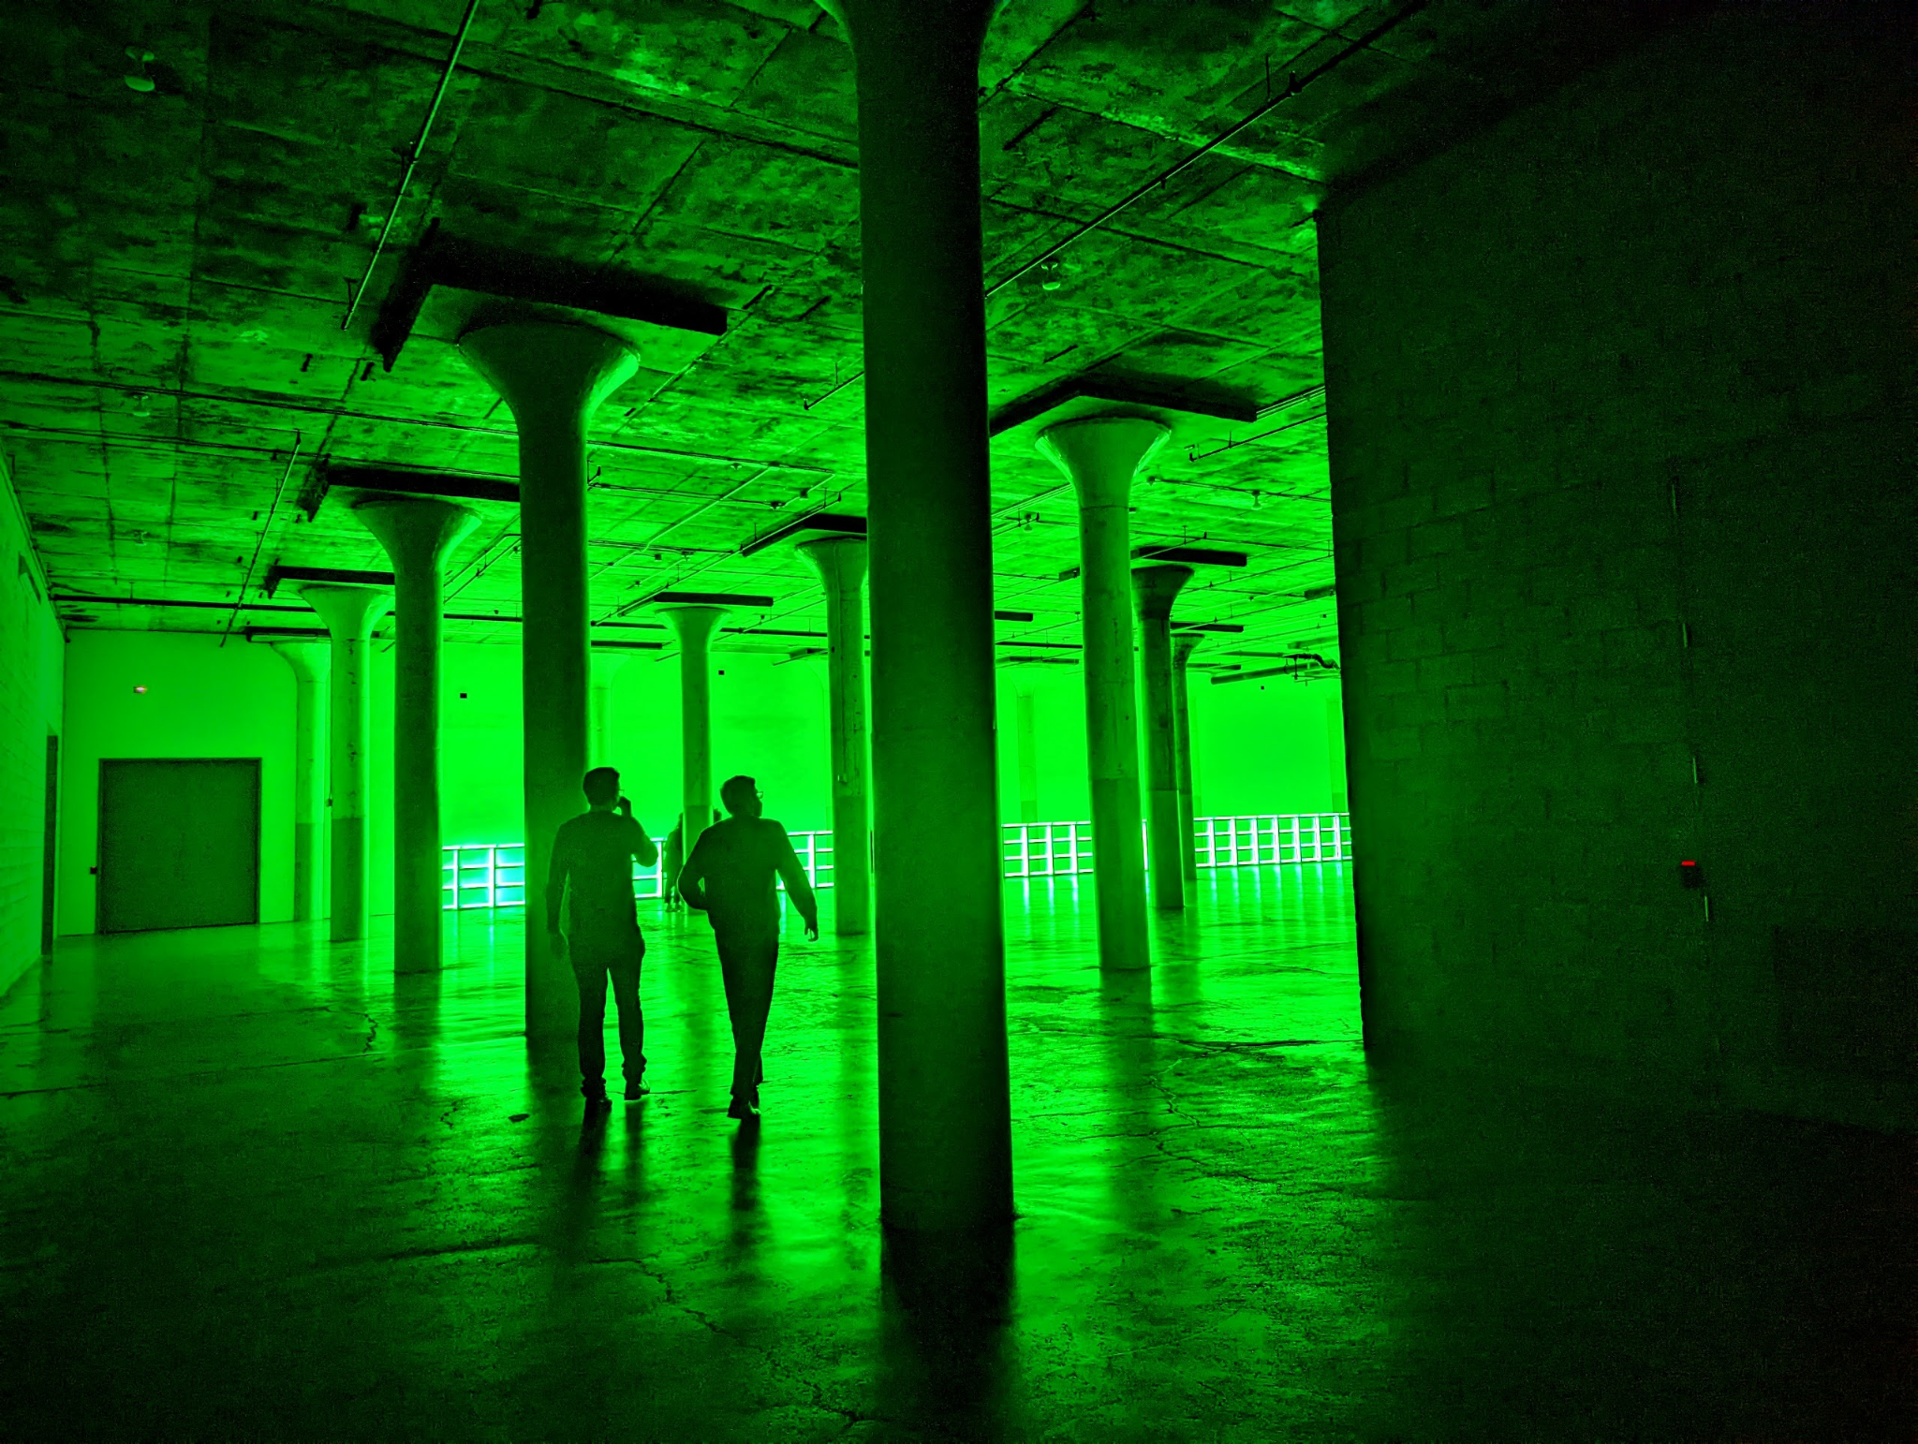
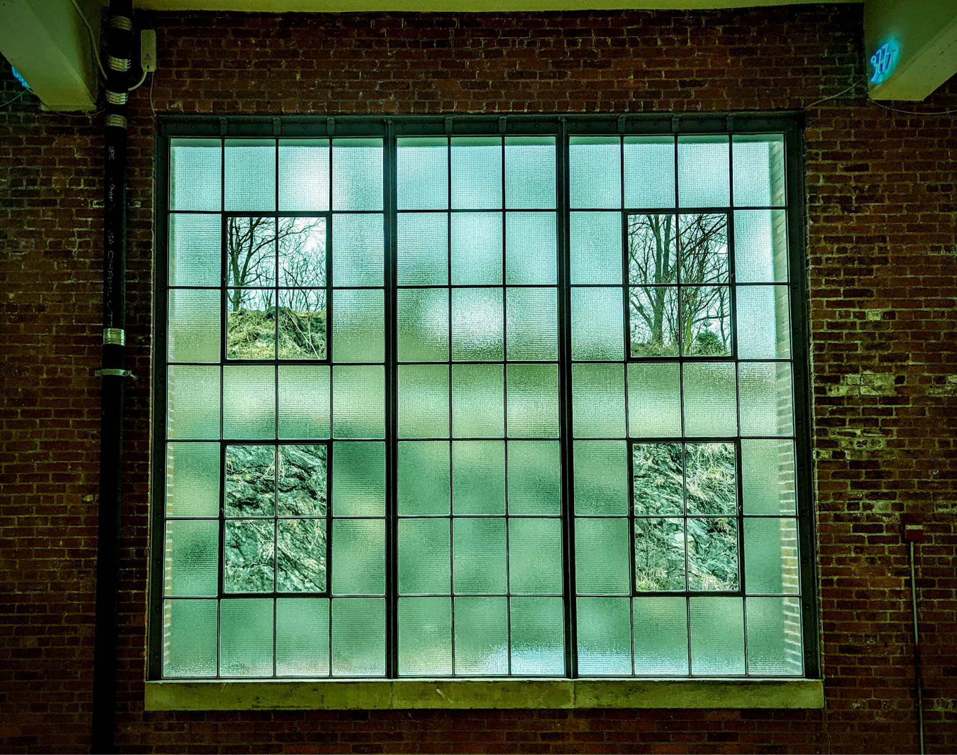
mev.day

Slide 21
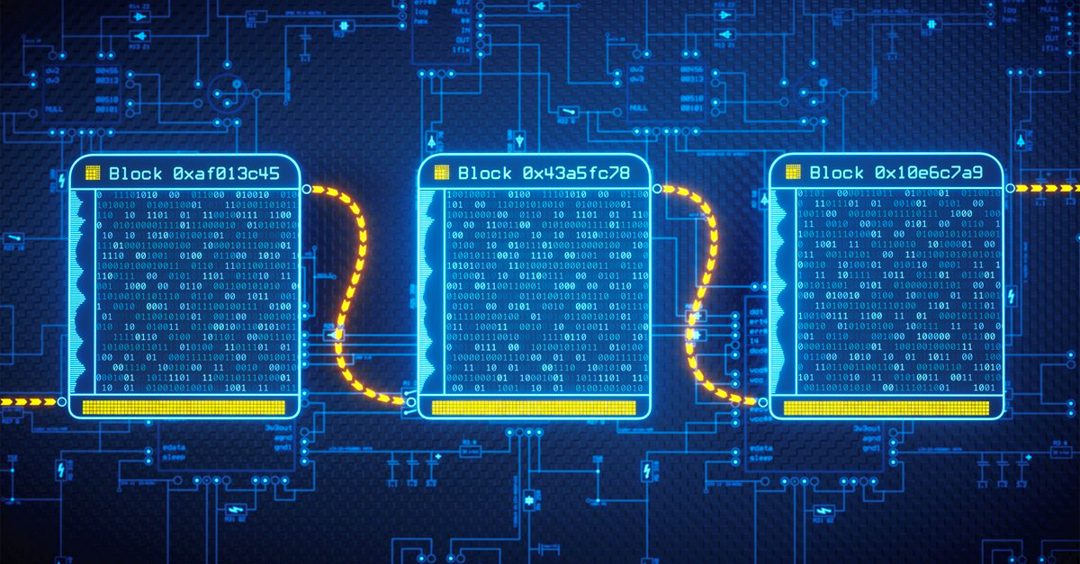
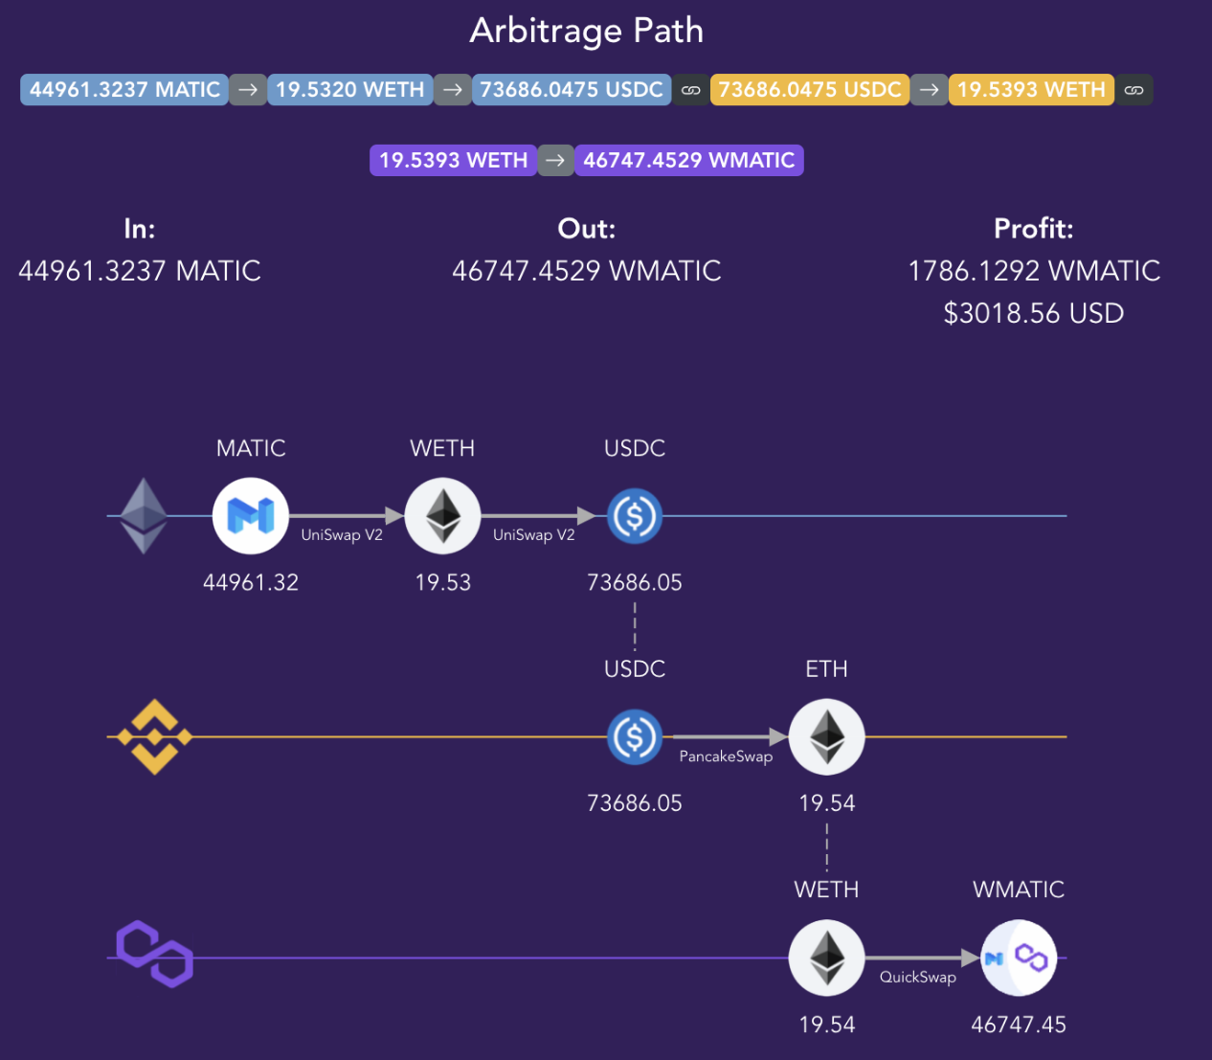

Cross-Chain MEV

Slide 22
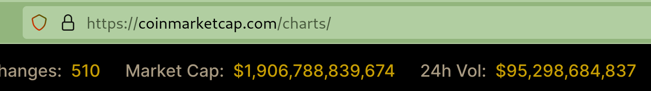
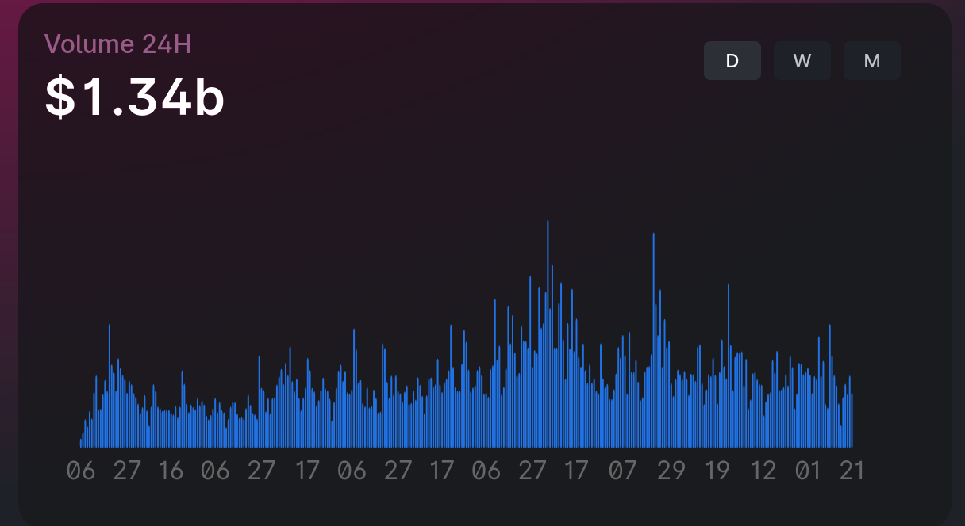
Still dark: the centralized world
MEV on FTX?????
Binance?
$95B >> $1.3B

Slide 23
wat do next? the future

Slide 24
wat do next?
We are on the precipice of centralizing all crypto.
There is now a choice.

Slide 25
wat do next?
attain understanding
preserve decentralization

Slide 26
wat do next?
make money
own the centralized stack

Slide 27
wat do next?
attain understanding
preserve decentralization
make money
own the centralized stack

Slide 28
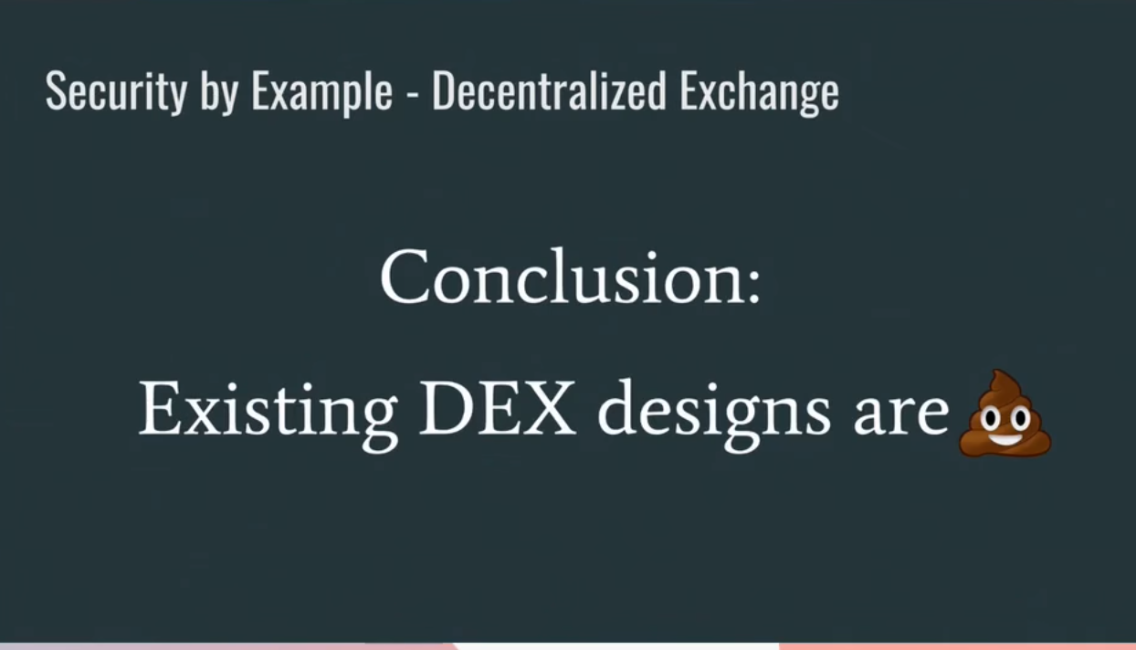
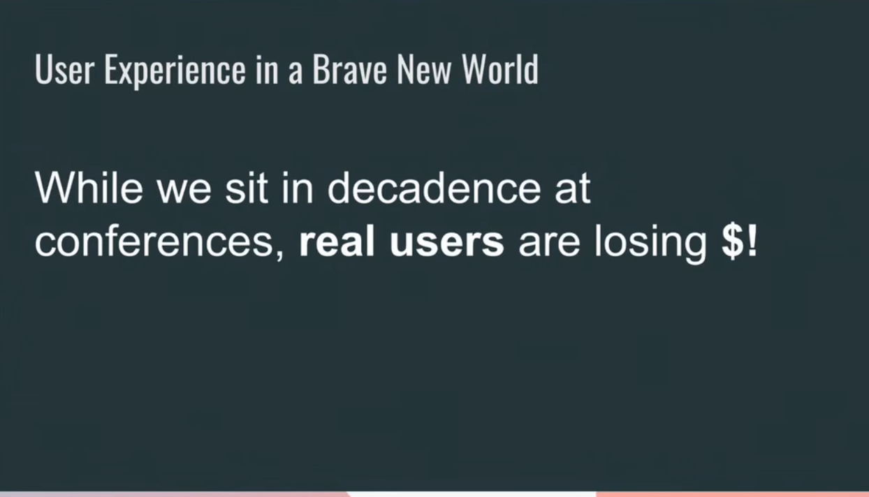

Slide 29
Is the MEV meme good or bad… for the world?

Slide 30
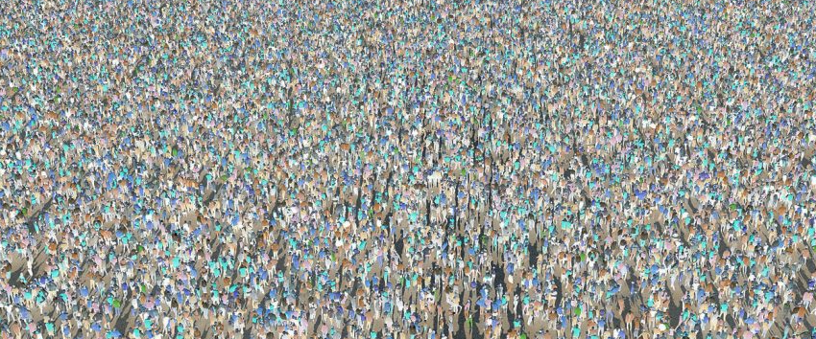
Is the MEV meme good or bad… for the world?

Slide 31
Is the MEV meme good or bad… for the world?
it’s up
to you

